Slide 1
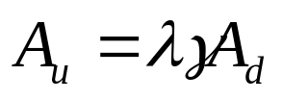
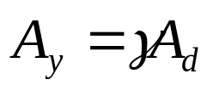
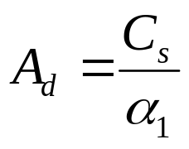

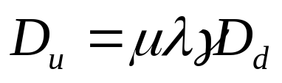
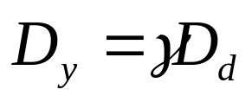
HAZUS Pushover Definition
Force
Ultimate Capacity
Yield Capacity
Design Capacity
Lateral
Displacement

Slide 2
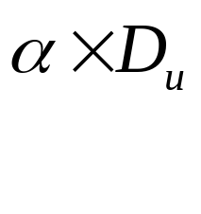
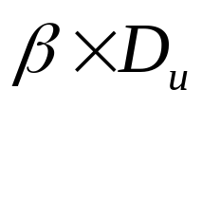
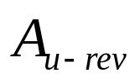
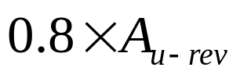
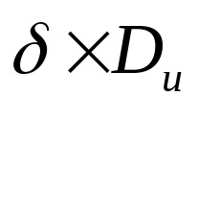
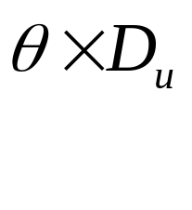
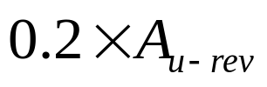
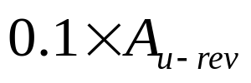
EQRM Pushover Definition – Limited Ductile
Force
Lateral
Displacement

Slide 3
EQRM Pushover Definition – Non Ductile (brittle)
Force
Lateral
Displacement

Slide 4
EQRM Degraded Pushover Definition – Summary
Pushover strength/behaviour linked to “backbone” infinitely ductile curve, both for strength and displacement.
Key strength level values a pre-set proportion of revised ultimate strength A_{u-rev} (0.8, 0.2, 0.1)
Corresponding displacement capacity values a user defined proportion of displacement at ultimate capacity (α, β, δ, θ)
Strength level pre-set proportion of revised ultimate strength (0.8, 0.2, 0.1)
Overall can define a wide range of pushover behaviours using four additional parameters.

